Slide 1
UML meets XP
presented by Andreas Floeck

Slide 2
Agenda
Introduction
  Waterfall Model
  eXtreme Programming
Pros and Cons of eXtreme Programming
Combined Approach XP/UML

Slide 3
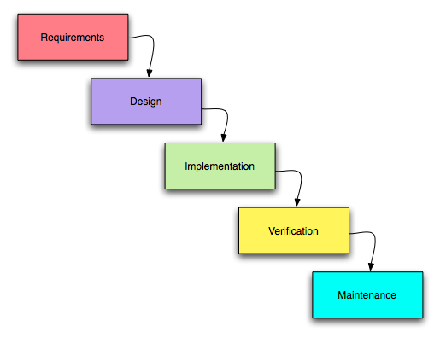
Introduction – Waterfall Model

Slide 4
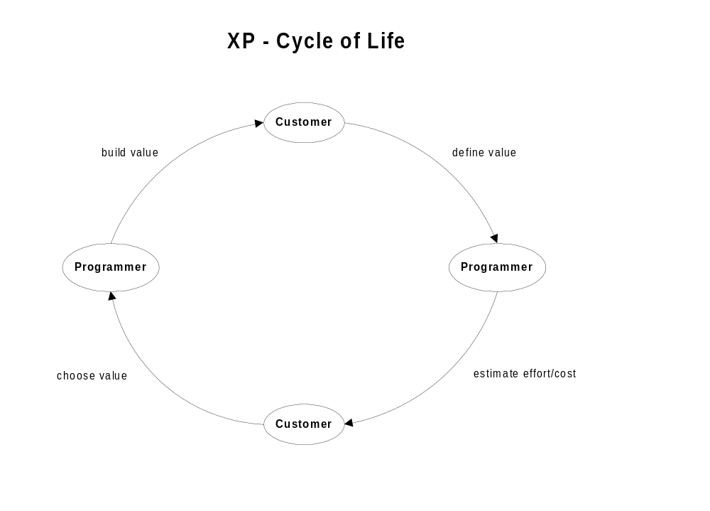
Introduction - XP

Slide 5
Introduction - XP
XP – 4 Values
  Communication
  Simplicity
  Feedback
  Courage

Slide 6
Pros and Cons of XP
Pros
  Rigorous Approach
  Tight Customer-Developer Loop
  Regression Testing
Cons
  No Abstractions
  No Separation:
  Analyst – Developer
  Component Interfaces, Design Patterns

Slide 7
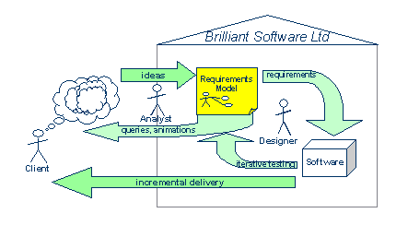
Combined Approach XP/UML

Slide 8
Benefits of Requirements Models
Exposure of Gaps/Inconsistencies
High-Level Requirements View
Damping Requirements Swings

Slide 9
UML meets XP
presented by Andreas Floeck

Slide 10
Resources
Paper “UML meets XP” by Alan C. Wills
http://www.trireme.com/whitepapers/process/xp-uml/paper.htm
Introduction to Software Engineering Design by Christopher Fox
Lecture “Agile Software Development” by Werner Wild (Management Center Innsbruck)

